Slide 1
Design of Sequential Circuits
2nd June-2020

Slide 2
Agenda
Design of Sequential Circuits
Design of Counters
Design with State equations
Analysis of Sequential circuits
Analysis of unused states

Slide 3
Design Procedure
Word description of the circuit behavior is stated (state diagram, timing diagram)
Obtain state table
State reduction
State assignment
Determine the number of flip-flops needed and assign a letter symbol to each
Choose the type of flip-flop to be used
From the state table, derive the circuit excitation and output tables.
Derive the circuit output functions and the flip-flop input functions
Draw the logic diagram

Slide 4
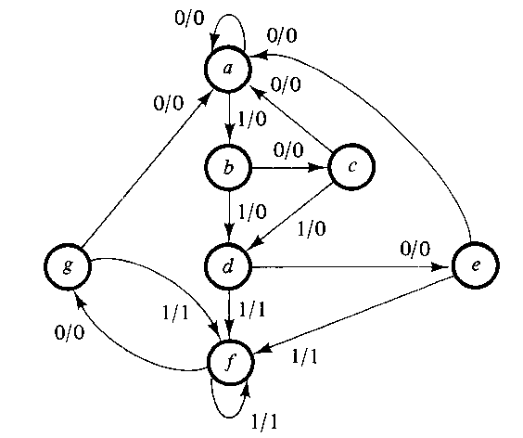
State diagram-Design of unused states

Slide 5
State Reduction – State Table
 | Next State |  | Output
Present State | x = 0 | x = 1 | x = 0 | x = 1
a | a | b | 0 | 0
b | c | d | 0 | 0
c | a | d | 0 | 0
d | e | f | 0 | 1
e | a | f | 0 | 1
f | g | f | 0 | 1
g | a | f | 0 | 1

Slide 6
Reducing the State Table
 | Next State |  | Output
Present State | x = 0 | x = 1 | x = 0 | x = 1
a | a | b | 0 | 0
b | c | d | 0 | 0
c | a | d | 0 | 0
d | e | f d | 0 | 1
e | a | f d | 0 | 1
f | g e | f | 0 | 1
g | a | f | 0 | 1

Slide 7
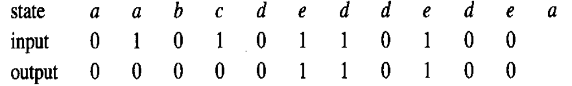
Reduced State Table
 | Next State |  | Output
Present State | x = 0 | x = 1 | x = 0 | x = 1
a | a | b | 0 | 0
b | c | d | 0 | 0
c | a | d | 0 | 0
d | e | d | 0 | 1
e | a | d | 0 | 1

Slide 8
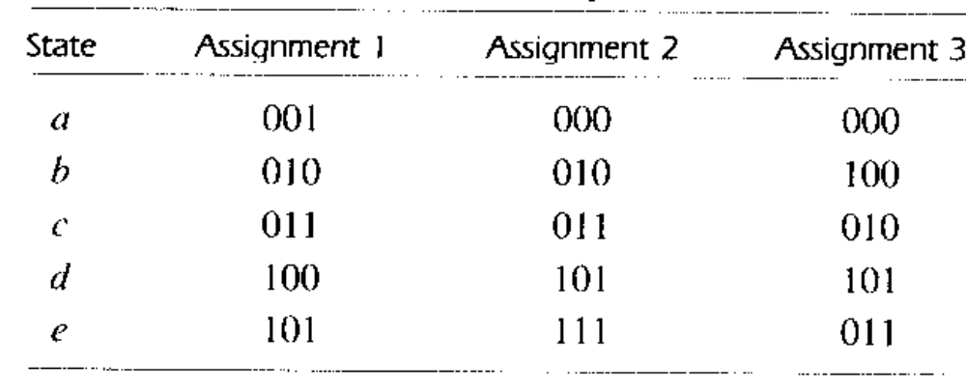
State Assignment
Three possible binary state assignment

Slide 9
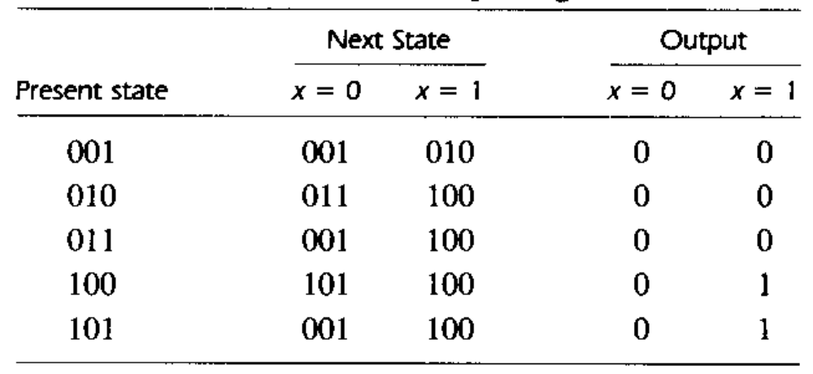
Reduced State Table with Binary Assignment 1

Slide 10
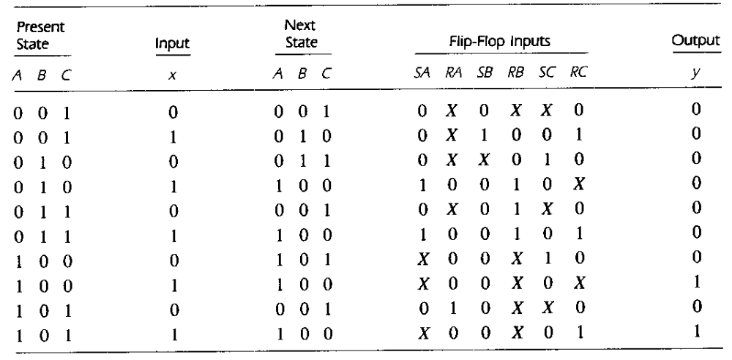
Design with unused states
State Table
Obtain the S_{A}, R_{A}, S_{B}, R_{B}, S_{C}, R_{C} and y expressions using K-Maps

Slide 11
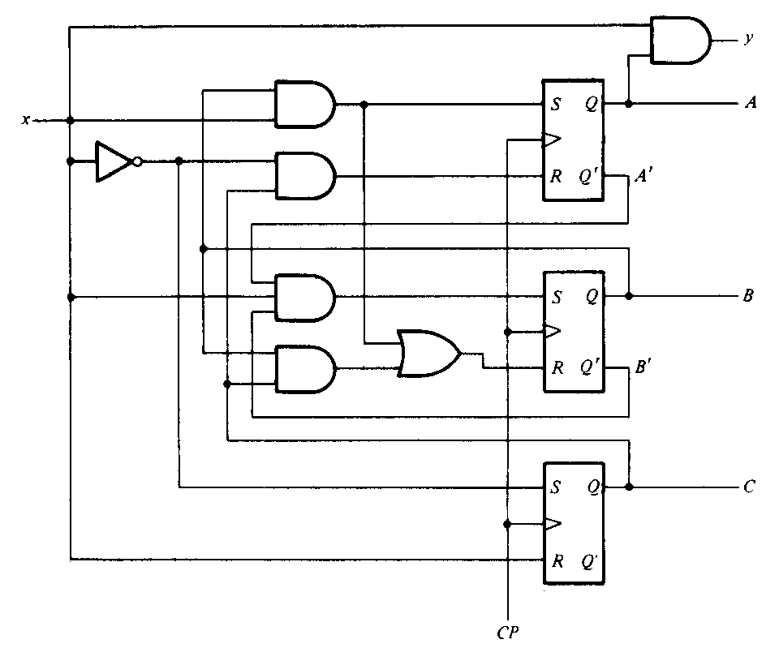
Logic diagram

Slide 12
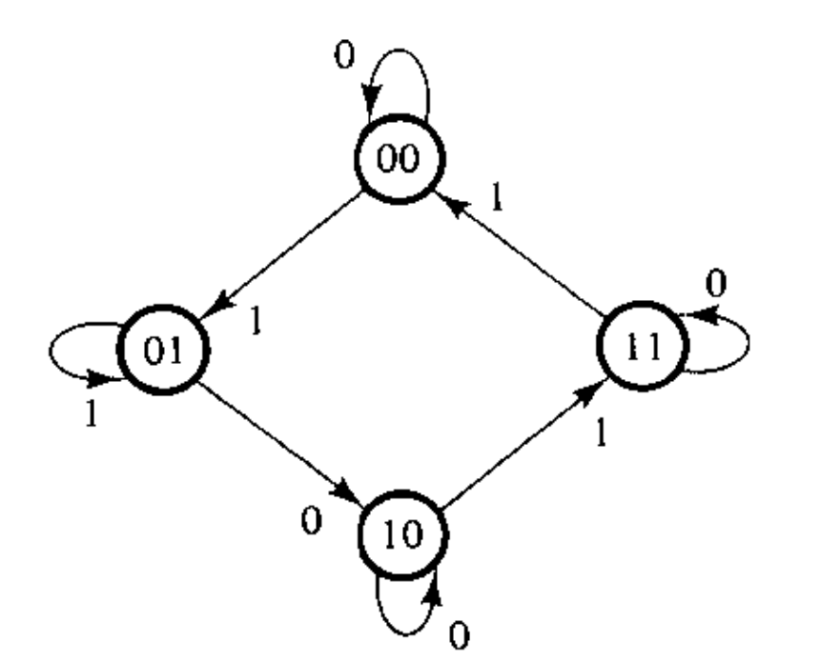
Step – 1 (State Diagram – description of the circuit)

Slide 13
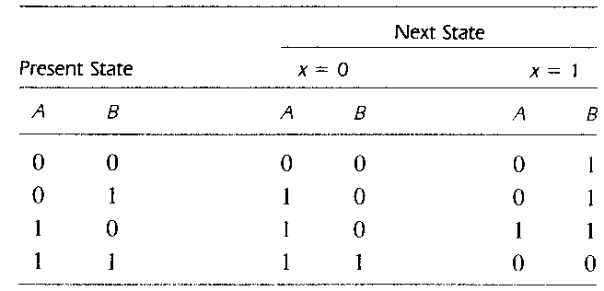
Step – 2 (State Table)
Step – 3 – no state reduction
Step – 4 – no state assignment
Step – 5 – number of flip-flops needed – 2
Step – 6 – type of flip flop – JK

Slide 14
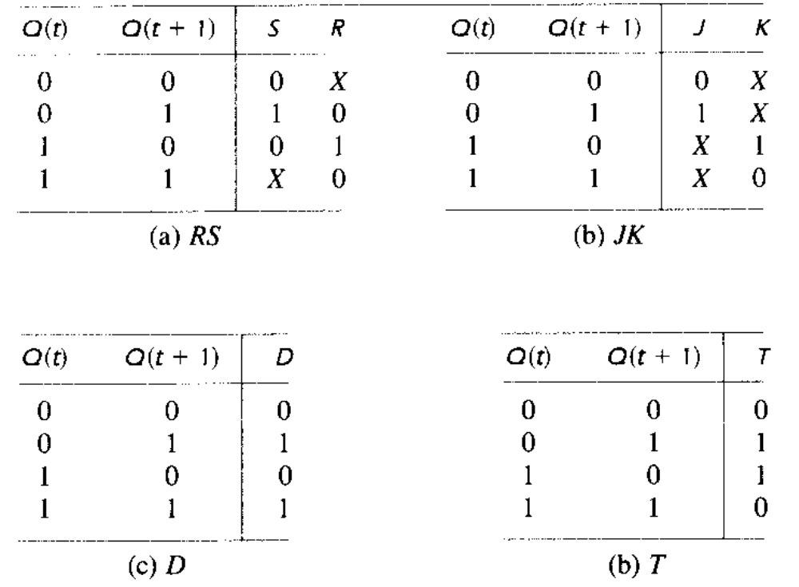
Flip – Flop Excitation Tables

Slide 15
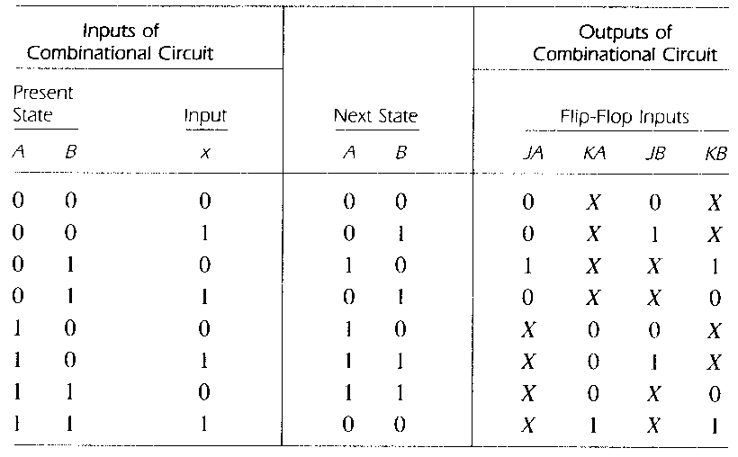
Step – 7 (Excitation Table)

Slide 16
Step – 8
Output functions and flip-flop input functions
In this example – no external output
B′x′ B′x Bx Bx′
B′x′ B′x Bx Bx′
A′
0
0
0
1
A′
x
x
x
x
A
x
x
x
x
A
0
0
1
0
J_{A} = Bx′
K_{A} = Bx
B′x′ B′x Bx Bx′
B′x′ B′x Bx Bx′
A′
0
1
x
x
A′
x
x
0
1
A
0
1
x
x
A
x
x
1
0
J_{B} = x
K_{B} = A′x′ + Ax

Slide 17
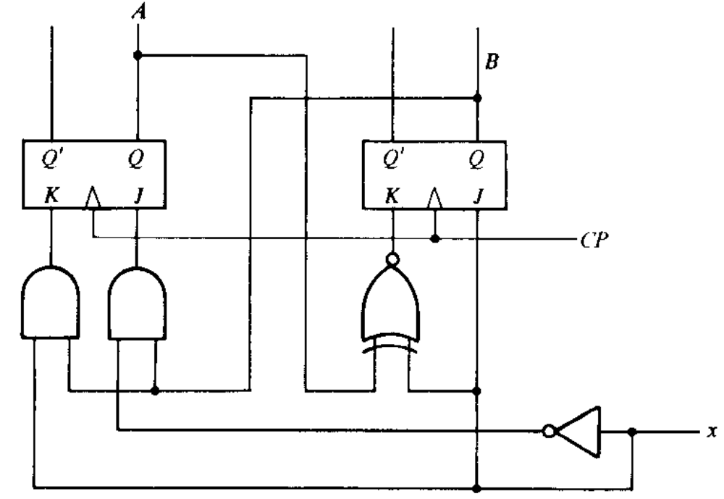
Step 9 – Logic Diagram

Slide 18
Design of Counters

Slide 19
Counter- A sequential circuit that goes through a prescribed sequence of states.
Sequence of states can follow a binary count or any other sequence.
Used for counting the number of occurrences of an event and for generating the timing signal

Slide 20
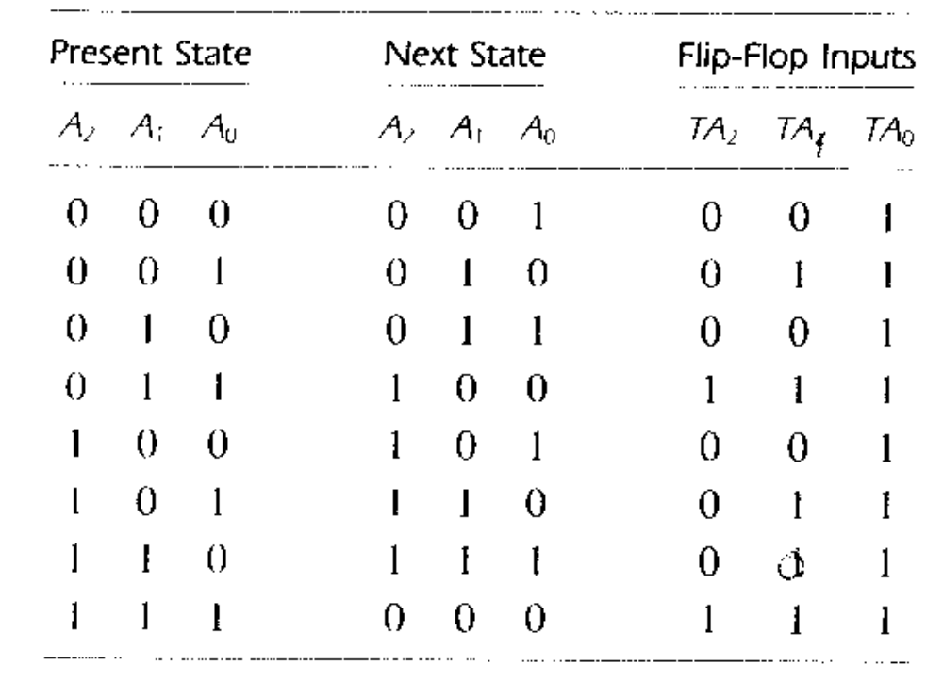
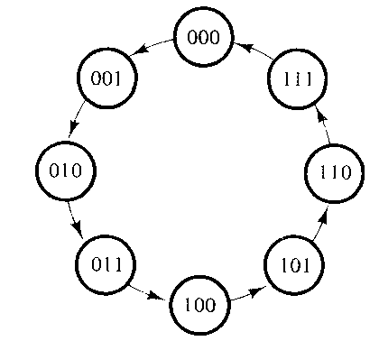
Design of Counters
State Diagram
Excitation Table

Slide 21
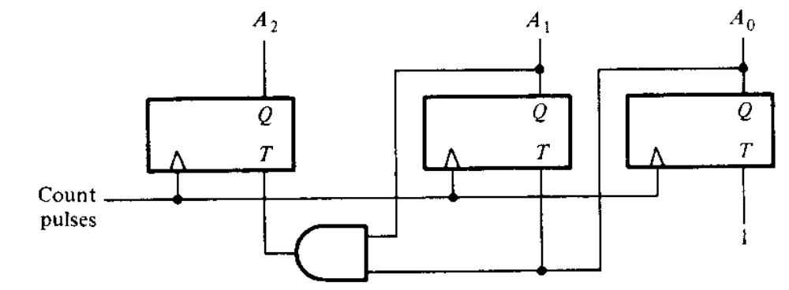
Logic diagram of a 3-bit binary counter
TA₂ = A₁A₀
TA₁=A₀
TA₀=1

Slide 22
Design a counter with the following binary sequence of states 0,1,2,4,5,6 using JK flip flops.

Slide 23
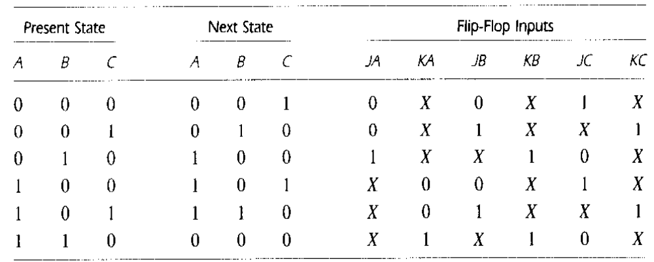
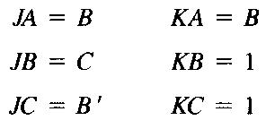
Example – 2 (Design of Counters)

Slide 24
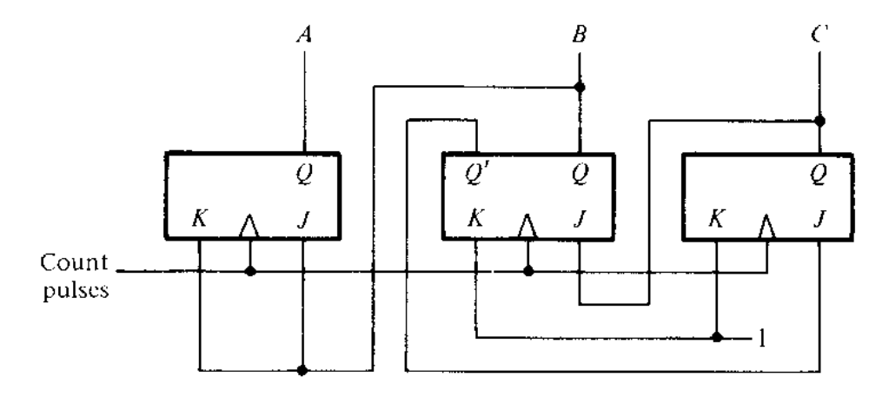
Logic Diagram

Slide 25
Design with State Equations
Design a sequential circuit with JK flip-flops to satisfy the following state equations:
A(t + 1) = A′B′CD + A′B′C + ACD + AC′D′
B(t + 1) = A′C + CD′ + A′BC′
C(t + 1) = B
D(t + 1) = D′

Slide 26
Design
A(t + 1) = A′B′CD + A′B′C + ACD + AC′D′
= (B′CD + B′C)A′ + (CD + C′D′)A
= J_{A}A′ + K_{A}′A
J_{A} = B′CD + B′C
K_{A} = (CD + C′D′)′
B(t + 1) = A′C + CD′ + A′BC′
= (A′C + CD′)(B + B′) + A′BC′
= (A′C + CD′)B′ + (A′C + CD′ + A′C′)B
J_{B} = A′C + CD′
K_{B} = (A′C + CD′ + A′C′)′ = (A′ + CD′)′ = A(C′ + D)

Slide 27
Design
C(t + 1) = B
= B(C + C′)
= BC′ + BC
J_{C} = B
K_{C} = B′
D(t + 1) = D′
J_{D} = 1
K_{D} = 0′ = 1

Slide 28
Analysis of Sequential Circuits

Slide 29
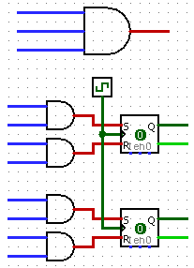
Example
Logic Diagram
x
y
A
B′
x
A′
B
x′
B′
A
x′
B
A
x
A′
B′

Slide 30
State Equations
A(t + 1) = S_{A} + R_{A}′A
S_{A} = x′B
R_{A} = xB′
A(t + 1) = x′B + (xB′)′ A
= x′B + x′A + AB
B(t + 1) = S_{B} + R_{B}′B
S_{B} = xA′
R_{B} = x′A
B(t + 1) = xA′ + (x′A)′B
= xA′ + xB + A′B
Here S_{A}, R_{A}, S_{B} and R_{B} are the Flip-Flop input equations

Slide 31
State Table
Present State |  | Next state |  |  |  | Output
 |  | x = 0 |  | x = 1 |  | x = 0 | x = 1
A | B | A | B | A | B | y | y
0 | 0 | 0 | 0 | 0 | 1 | 0 | 0
0 | 1 | 1 | 1 | 0 | 1 | 0 | 0
1 | 0 | 1 | 0 | 0 | 0 | 0 | 1
1 | 1 | 1 | 0 | 1 | 1 | 0 | 0

Slide 32
State Diagram
0 / 0
00
1 / 0
1 / 1
01
10
1 / 0
0 / 0
0 / 0
0 / 0
11
1 / 0

Slide 33
Analysis of using unused states-first example of design
Self starting and Self correcting – goes from invalid to valid state and continues operation
Any cycle among unused states must be avoided. If occurs, circuit should be redesigned.

Slide 34
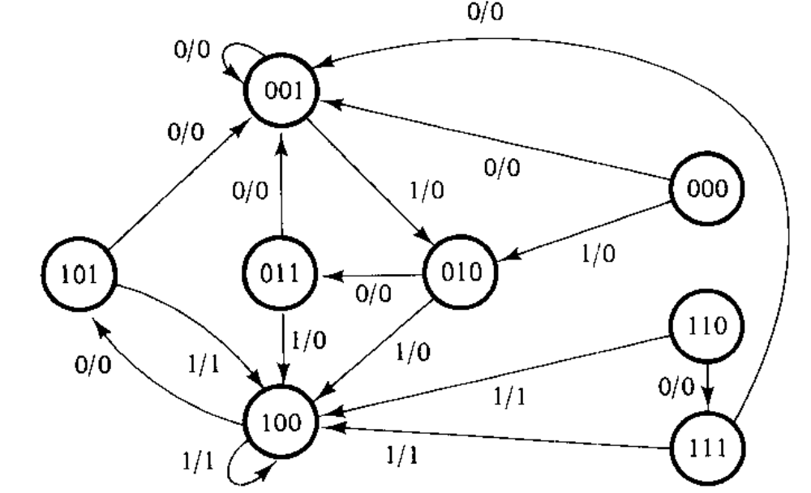
State Diagram

Slide 35
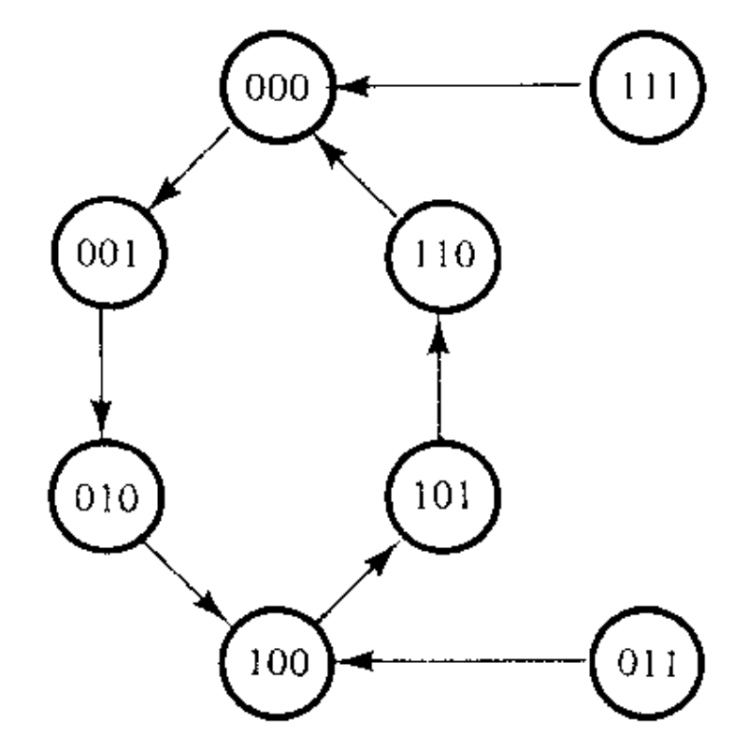
State Diagram-Counter example-1 in design
Self starting counter:
Counter which starts from any state but eventually reaches the normal count sequence.

Slide 36
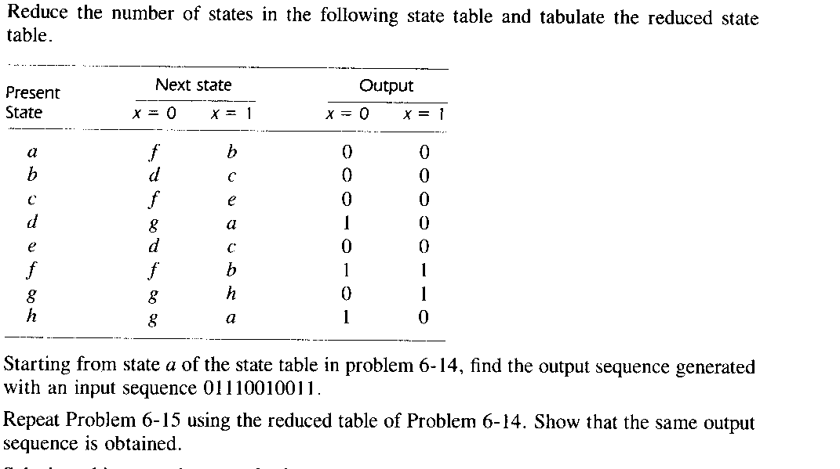
Problems

Slide 37
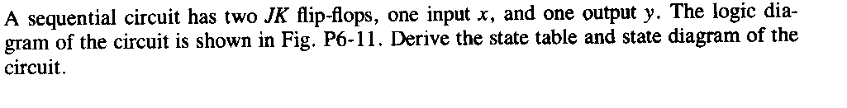
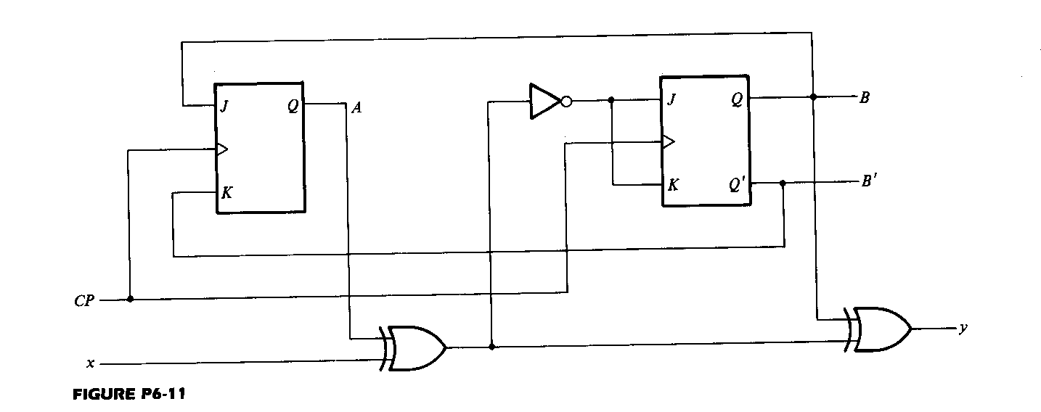

Slide 38
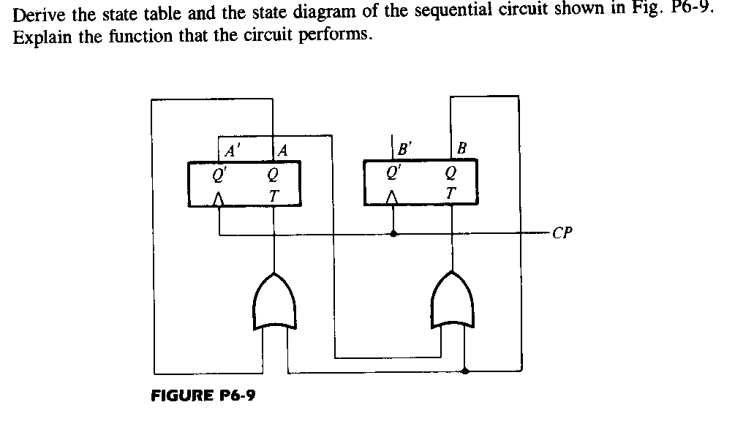

Slide 39
References
M.Morris Mano, “Digital Design”, 3rd Edition
M.Morris Mano, “Digital Logic and Computer Design”, PHI

